Slide 1
모바일 안드로이드 응용 실습
3차 프로젝트
20143175 정동묵

Slide 2
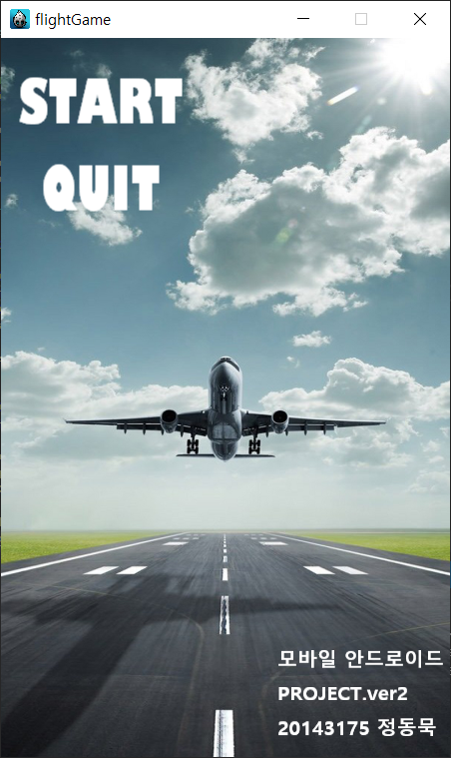
배경 설정, 시작 버튼과 게임종료 버튼 생성
Start 라벨과 quit 라벨을 MenuItemLabel을 통해 Menu로 불러 올수 있도록 item으로 정의
START 버튼을 누르면 replaceScene 함수를 통해 TransitionSplitRows 효과를 보여주면서 게임화면(GameScene)으로 전환
QUIT 버튼을 통해 end() 함수 호출, 게임을 종료

Slide 3
MenuScene.cpp
auto bgLayer = Layer::create();
this->addChild(bgLayer);
auto layer_1 = Sprite::create("startScene_2.png"); //450*720
layer_1->setAnchorPoint(Point::ZERO);
layer_1->setPosition(Point::ZERO);
bgLayer->addChild(layer_1);
auto label_start = Label::createWithSystemFont("START", "Gill Sans Ultra Bold Condensed", 60);
label_start->setColor(Color3B::WHITE);
auto label_quit = Label::createWithSystemFont("QUIT", "Gill Sans Ultra Bold Condensed", 60);
label_quit->setColor(Color3B::WHITE);
auto item_1 = MenuItemLabel::create(label_start, CC_CALLBACK_1(MenuScene::changeScene, this));
auto item_2 = MenuItemLabel::create(label_quit, CC_CALLBACK_1(MenuScene::menuCallback, this));
auto menu = Menu::create(item_1, item_2, nullptr);
menu->alignItemsVertically();
menu->setPosition(Vec2(100, 610));
this->addChild(menu);
return true;
}
void MenuScene::changeScene(Ref* sender)
{
auto scene = TransitionSplitRows::create(1.5, GameScene::createScene());
Director::getInstance()->replaceScene(scene);
}
void MenuScene::StartMusic() ⬅ 음악이 시작되고 중지되는 함수 추가
{
CocosDenshion::SimpleAudioEngine* music = CocosDenshion::SimpleAudioEngine::getInstance();
music->playBackgroundMusic("LetsHuntAliens.mp3");
}
void MenuScene::StopMusic()
{
SimpleAudioEngine::getInstance()->stopBackgroundMusic();
}
void MenuScene::menuCallback(Ref* pSender)
{
Director::getInstance()->end();
}

Slide 4
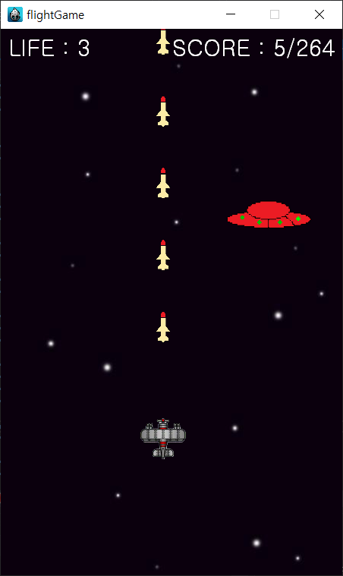
public:
static cocos2d::Scene* createScene();
virtual bool init();
//void menuCloseCallback(cocos2d::Ref* pSender);
CREATE_FUNC(GameScene);
Size winSize; ⬅윈도우 크기 저장
Vec2 location; ⬅마우스 위치 저장
Vec2 locationPlane; ⬅마우스 클릭시 저장되는 비행기 위치
Vector<Sprite*> ufos, redufos, items, missiles; ⬅ 미사일,, UFO,, 아이템 저장
bool isGetItem; ⬅아이템 획득여부 확인 장치
bool isTurn; ⬅게임이 끝나면 다시 메뉴화면으로 돌아가기 위한 장치
void update(float delta);
void initData(); ⬅초기화할 데이터 모음
void initBG(); ⬅배경화면
void initPlane(); ⬅사용자 (비행기)
void initScore(); ⬅점수초기화
void initLife(); ⬅사용자 목숨 초기화
void setLabelLife(); ⬅남은 목숨을 확인할 수 있는 라벨
void setParticle(); ⬅파티클 생성
int newScore,score, highscore, life; ⬅점수,최고점수,목숨을 int로 받음
void setMissile(float delta); ⬅미사일
void resetMissile(Ref* sender); ⬅미사일 리셋
void setUfo(float delta); ⬅UFO(적)
void resetUfo(Ref* sender); ⬅UFO 리셋
void resetRedUfo(Ref* sender); ⬅빨간 UFO 추가
void GameOver(); ⬅게임이 끝났음을 알려주는 라벨
void allStop(); ⬅ 스케쥴이벤트 종료
void changeScenes(Ref* sender); ⬅화면 전환
void resetContain(); ⬅현재 화면의 리스트 초기화
bool onTouchBegan(Touch* touch, Event* unused_event);
void onTouchMoved(Touch* touch, Event* unused_event);
void StartMusic(); ⬅배경음악
void StopMusic();
GameScene.h

Slide 5
GameScene.cpp
bool GameScene::init()
{
if (!Scene::init())
{
return false;
}
auto listener = EventListenerTouchOneByOne::create();
listener->onTouchBegan = CC_CALLBACK_2(GameScene::onTouchBegan, this); ⬅ 마우스로 비행기를 누를때마다 이벤트가
listener->onTouchMoved = CC_CALLBACK_2(GameScene::onTouchMoved, this); ⬅발생할 수 있게 도와준다.
Director::getInstance()->getEventDispatcher()
->addEventListenerWithFixedPriority(listener, 1);
initData(); ⬅ 게임이 새로 시작될때 초기화해줄 데이터들 모음
initBG(); ⬅ 게임배경화면
initPlane(); ⬅ 사용자(비행기)
initScore(); ⬅ 점수화면
initLife(); ⬅ 남은 목숨값
StartMusic(); ⬅ 배경음악 재생
this->scheduleUpdate();
this->schedule(schedule_selector(GameScene::setMissile), 0.2); ⬅ 미사일은 0.2초 마다 발사
this->schedule(schedule_selector(GameScene::setUfo), 0.5 * (rand() % 10)); ⬅ UFO는 5초 보다 빠른 시간으로 랜덤으로 생성
this->schedule(schedule_selector(GameScene::setItem), 5.0 + rand() % 4); ⬅ 아이템이 5~9초마다 생성
newScore = 0; ⬅ 게임이 시작되면 점수 0으로 초기화
return true;
}

Slide 6
GameScene.cpp
void GameScene::initData()
{
winSize = Director::getInstance()->getWinSize(); ⬅ 윈도우 크기 저장
ufos.clear(); ⬅ UFO들 초기화
missiles.clear(); ⬅ 미사일들 초기화
redufos.clear(); ⬅ 빨간색 UFO 초기화
items.clear(); ⬅ 아이템 초기화
life = 3; ⬅ 목숨값 3으로 시작
isGetItem = false; ⬅ 아이템 효과 비활성화
newScore = 0; ⬅ 점수 0으로 시작
highscore = UserDefault::getInstance()->getIntegerForKey("HIGH_SCORE", 0);
}
void GameScene::initBG()
{
auto bgLayer = Layer::create();
this->addChild(bgLayer);
auto layer_1 = Sprite::create("darkSky.jpg"); //1067 x 1600 ⬅ 우주 느낌의 배경화면 추가
layer_1->setAnchorPoint(Point::ZERO);
layer_1->setPosition(Point::ZERO);
bgLayer->addChild(layer_1);
auto layer_2 = Sprite::create("darkSky.jpg", Rect(0, 0, 967, 1500)); ⬅ 화면이 매끄럽게 이어지도록 같은 화면 추가
layer_2->setAnchorPoint(Vec2::ZERO);
layer_2->setPosition(Vec2(0, 1600));
bgLayer->addChild(layer_2);
auto action_0 = MoveBy::create(20.0, Point(0, -1600));
auto action_1 = Place::create(Point::ZERO);
auto action_2 = Sequence::create(action_0, action_1, NULL);
auto action_3 = RepeatForever::create(action_2);
bgLayer->runAction(action_3); ⬅ 화면이 무한하게 반복됨
}

Slide 7
GameScene.cpp
void GameScene::initPlane() ⬅ 비행기 추가
{
SpriteFrameCache::getInstance()->addSpriteFramesWithFile("airplane.plist");
auto plane_1 = Sprite::create("airplane.png");
plane_1->setPosition(Vec2(winSize.width / 2, winSize.height / 4));
plane_1->setTag(TAG_SPRITE_PLANE);
plane_1->setScale(0.5);
this->addChild(plane_1,1);
auto animation = Animation::create();
animation->setDelayPerUnit(0.2);
for (int i = 1; i < 4; i++) {
auto frame = SpriteFrameCache::getInstance()->getSpriteFrameByName(StringUtils::format("plane_%d.png", i));
animation->addSpriteFrame(frame);
}
auto animate = Animate::create(animation);
plane_1->runAction(RepeatForever::create(animate));
}

Slide 8
GameScene.cpp
void GameScene::setMissile(float delta) ⬅ 미사일 추가
{
auto plane_1 = (Sprite*)this->getChildByTag(TAG_SPRITE_PLANE);
Sprite* missile_1;
//아이템을 먹을 경우 강한 불빛으로 변경
if (isGetItem) {
missile_1 = Sprite::create("fire.png");
missile_1->setScale(0.15);
missile_1->setTag(5);
}
else {
missile_1 = Sprite::create("missile_1.png");
missile_1->setScale(0.05);
missile_1->setTag(1);
}
missile_1->setPosition(plane_1->getPosition() + Vec2(0, 100));
this->addChild(missile_1);
missiles.pushBack(missile_1);
auto action = Sequence::create(MoveBy::create(1.5, Vec2(0, winSize.height-10)),
CallFuncN::create(CC_CALLBACK_1(GameScene::resetMissile, this)),
NULL);
missile_1->runAction(action);
}
void GameScene::resetMissile(Ref* sender) {) ⬅ 미사일 제거
auto missile_1 = (Sprite*)sender;
missiles.eraseObject(missile_1);
this->removeChild(missile_1);
}

Slide 9
GameScene.cpp
void GameScene::setItem(float delta) ⬅ 아이템 추가
{
int x = PADDING_SCREEN + rand() % ((int)winSize.width - PADDING_SCREEN * 2);
auto item = Sprite::create("item.png");
item->setScale(0.5);
item->setPosition(Vec2(x, winSize.height));
this->addChild(item);
items.pushBack(item);
auto action = Sequence::create(
MoveBy::create(3.0, Vec2(0, -winSize.height)),
CallFuncN::create(CC_CALLBACK_1(GameScene::resetItem, this)),
NULL);
item->runAction(action);
}
void GameScene::resetItem(Ref* sender) ) ⬅ 아이템이 없어질시 아이템 리스트 제거
{
auto item = (Sprite*)sender;
items.eraseObject(item);
this->removeChild(item);
}
void GameScene::resetGetItem(float delta)
{
isGetItem = false;
}

Slide 10
GameScene.cpp
void GameScene::setUfo(float delta) ⬅ 우주선 설정
{
float x = PADDING_SCREEN + rand() % ((int)winSize.width - PADDING_SCREEN * 2);
Sprite* ufo_red;
Sprite* ufo;
if (rand() % 100 < 30) {⬅ 30의 확률로 빨간색 우주선 생성
SpriteFrameCache::getInstance()->addSpriteFramesWithFile("ufo_red.plist");
ufo_red = Sprite::create("ufo_red.png");
ufo_red->setScale(0.4);
ufo_red->setTag(5);
auto animation = Animation::create();
animation->setDelayPerUnit(0.2);
for (int i = 1; i < 6; i++) {
auto frame = SpriteFrameCache::getInstance()->getSpriteFrameByName(StringUtils::format("ufo_red %d.png", i));
animation->addSpriteFrame(frame);
}
auto animate = Animate::create(animation);
ufo_red->runAction(RepeatForever::create(animate));
ufo_red->setPosition(Point(x, winSize.height) + Vec2(0, 250));
this->addChild(ufo_red);
ufos.pushBack(ufo_red);
auto action = Sequence::create(
MoveBy::create(4.0, Vec2(0, -1600 - 200)),
CallFuncN::create(CC_CALLBACK_1(GameScene::resetUfo, this)),
NULL);
ufo_red->runAction(action);
}

Slide 11
GameScene.cpp
else { ⬅ 나머지의 확률로 초록색 우주선 생성
SpriteFrameCache::getInstance()->addSpriteFramesWithFile("ufo_green.plist");
ufo = Sprite::create("ufo_green.png");
ufo->setScale(0.4);
ufo->setTag(1);
auto animation = Animation::create();
animation->setDelayPerUnit(0.2);
for (int i = 1; i < 6; i++) {
auto frame = SpriteFrameCache::getInstance()->getSpriteFrameByName(StringUtils::format("ufo_green %d.png", i));
animation->addSpriteFrame(frame);
}
auto animate = Animate::create(animation);
ufo->runAction(RepeatForever::create(animate));
ufo->setPosition(Point(x, winSize.height) + Vec2(0, 250));
this->addChild(ufo);
ufos.pushBack(ufo);
auto action = Sequence::create(
MoveBy::create(4.0, Vec2(0, -1600 - 200)),
CallFuncN::create(CC_CALLBACK_1(GameScene::resetUfo, this)),
NULL);
ufo->runAction(action);
}
}

Slide 12
GameScene.cpp
void GameScene::resetRedUfo(Ref* sender) ⬅ 빨간색 우주선 제거
{
auto ufo_red = (Sprite*)sender;
redufos.eraseObject(ufo_red);
this->removeChild(ufo_red);
}
void GameScene::resetUfo(Ref* sender) ⬅ 초록색 우주선 제거
{
auto ufo = (Sprite*)sender;
ufos.eraseObject(ufo);
this->removeChild(ufo);
}
void GameScene::setParticle() ⬅ 파티클설정
{
Sprite* plane_1 = (Sprite*)this->getChildByTag(TAG_SPRITE_PLANE);
SimpleAudioEngine::getInstance()->playEffect("explosion.mp3");
auto particle = ParticleSystemQuad::create("particle_texture_2.plist");
particle->setPosition(plane_1->getPosition());
particle->setScale(0.5);
auto action = Sequence::create(DelayTime::create(0.5), CallFuncN::
create(CC_CALLBACK_1(GameScene::resetParticle, this)), NULL);
this->addChild(particle);
particle->runAction(action);
}
void GameScene::resetParticle(Ref* sender) ⬅ 파티클 제거
{
auto particle = (Sprite*)sender;
this->removeChild(particle);
}

Slide 13
GameScene.cpp
void GameScene::sum(int score) ⬅ 점수 추가
{
newScore += score;
if (newScore >= UserDefault::getInstance()->getIntegerForKey("HIGHSCORE")) {
newScore = UserDefault::getInstance()->getIntegerForKey("HIGHSCORE");
UserDefault::getInstance()->setIntegerForKey("HIGHSCORE",
UserDefault::getInstance()->getIntegerForKey("HIGHSCORE"));
UserDefault::getInstance()->flush();
}
auto label = (Label*)this->getChildByTag(TAG_LABEL_HIGHSCORE);
label->setString(StringUtils::format("SCORE : %d/%d", newScore,
UserDefault::getInstance()->getIntegerForKey("HIGHSCORE")));
}

Slide 14
GameScene.cpp
void GameScene::update(float delta) ⬅충돌효과
{
Sprite* plane_1 = (Sprite*)this->getChildByTag(TAG_SPRITE_PLANE);
Rect rectPlane = Rect(plane_1->getPositionX() - 10,
plane_1->getPositionY() - 10, 15, 15);
auto removeSpr = Sprite::create();
for (Sprite* sprItem : items) {
Rect rectItem = sprItem->getBoundingBox(); ⬅ 아이템과 플레이어가 부딪히면 효과음 + 아이템이 사라지면서 isGetItem true 반환=> 미사일 강화
if (rectPlane.intersectsRect(rectItem)) {
SimpleAudioEngine::getInstance()->playEffect("levelup.mp3");
removeSpr = sprItem;
}
}
if (items.contains(removeSpr)) {
resetItem(removeSpr);
isGetItem = true;
this->scheduleOnce(schedule_selector(GameScene::resetGetItem), 5.0);
}
auto removeMissile = Sprite::create();
auto removeUfo = Sprite::create();
auto removeRedUfo = Sprite::create();

Slide 15
GameScene.cpp
for (Sprite* missile_1 : missiles) {
Rect rectMissile = missile_1->getBoundingBox();
for (Sprite* ufo : ufos) {
Rect rectUfo = ufo->getBoundingBox();
if (rectMissile.intersectsRect(rectUfo)) { ⬅ 미사일과 적이 충돌할 경우
int attack = missile_1->getTag();
int hp = ufo->getTag();
removeMissile = missile_1;
//피가 0보다 많을시 -1
if (hp - attack > 0) {
ufo->setTag(hp - attack);
}
else {
removeUfo = ufo; ⬅ 피가0이되면 적 제거
SimpleAudioEngine::getInstance()->playEffect("Laser_Shoot.wav");
auto particle = ParticleSystemQuad::create("particle_texture.plist");
particle->setPosition(ufo->getPosition());
particle->setScale(0.5);
auto action = Sequence::create(DelayTime::create(0.5), CallFuncN::
create(CC_CALLBACK_1(GameScene::resetParticle, this)), NULL);
this->addChild(particle);
particle->runAction(action);
sum(1);
}
}

Slide 16
GameScene.cpp
if(rectPlane.intersectsRect(rectUfo)) {⬅ 비행기와 적이 충돌할 경우
if (life > 0) {
life--;
UserDefault::getInstance()->setIntegerForKey("Life", life);
UserDefault::getInstance()->flush();
auto labelScore = (Label*)this->getChildByTag(TAG_LABEL_LIFE);
labelScore->setString(StringUtils::format("Life : %d", life));
resetContain();
setLabelLife();
setParticle();
}
if (life == 0){
setParticle();
GameOver();
allStop();
resetContain();
}
}
}

Slide 17
GameScene.cpp
for (Sprite* ufo_red : redufos) {
Rect rectRedUfo = ufo_red->getBoundingBox();
if (rectMissile.intersectsRect(rectRedUfo)) { ⬅ 미사일과 적이 충돌할 경우
int attack = missile_1->getTag();
int hp = ufo_red->getTag();
removeMissile = missile_1;
if (hp - attack > 0) {
ufo_red->setTag(hp - attack);
}
else {
SimpleAudioEngine::getInstance()->playEffect("Laser_Shoot.wav");
removeRedUfo = ufo_red;
auto particle = ParticleSystemQuad::create("particle_texture.plist");
particle->setPosition(ufo_red->getPosition());
particle->setScale(0.5);
auto action = Sequence::create(DelayTime::create(0.5), CallFuncN::
create(CC_CALLBACK_1(GameScene::resetParticle, this)), NULL);
this->addChild(particle);
particle->runAction(action);
sum(10);
}
}

Slide 18
GameScene.cpp
if (rectPlane.intersectsRect(rectRedUfo)) { ⬅ 비행기와 적이 충돌할 경우
if (life > 0) {
life--;
UserDefault::getInstance()->setIntegerForKey("Life", life);
UserDefault::getInstance()->flush();
auto labelScore = (Label*)this->getChildByTag(TAG_LABEL_LIFE);
labelScore->setString(StringUtils::format("Life : %d", life));
resetContain();
setLabelLife();
setParticle();
}
if(life == 0) {
setParticle();
GameOver();
allStop();
resetContain();
}
}
}
}
if (missiles.contains(removeMissile)) { ⬅ 미사일,UFO 모두 제거
resetMissile(removeMissile);
resetUfo(removeUfo);
resetRedUfo(removeRedUfo);
}
}

Slide 19
GameScene.cpp
bool GameScene::onTouchBegan(Touch* touch, Event* unused_event) ⬅ 마우스 클릭시 비행기가 마우스의 위치로 이동
{
location = touch->getLocation();
auto plane_1 = (Sprite*)this->getChildByTag(1);
locationPlane = plane_1->getPosition();
if (isTurn) { ⬅isTurn함수가 true일 경우 화면 전환
auto scene = TransitionPageTurn::create(1.0, MenuScene::createScene(), true);
Director::getInstance()->replaceScene(scene);
isTurn = false;
}
return true;
}
void GameScene::onTouchMoved(Touch* touch, Event* event)
{
Vec2 locationTouch = touch->getLocation();
Vec2 moveArea = locationTouch - location;
auto plane_1 = (Sprite*)this->getChildByTag(1);
plane_1->setPosition((locationPlane + moveArea).x, winSize.height / 4); ⬅ 비행기는 x좌표만 변하면서 이동
}

Slide 20
GameScene.cpp
void GameScene::allStop() ⬅게임이 끝나면 스케쥴러 종료
{
this->unschedule(schedule_selector(GameScene::setMissile));
this->unschedule(schedule_selector(GameScene::setUfo));
this->unschedule(schedule_selector(GameScene::setItem));
}
void GameScene::resetContain() ⬅화면에 있는 물체 모두 제거
{
for (Sprite* missile_1 : missiles) {
removeChild(missile_1);
}
for (Sprite* ufo : ufos) {
removeChild(ufo);
}
for (Sprite* ufo_red : redufos) {
removeChild(ufo_red);
}
for (Sprite* item : items) {
removeChild(item);
}
}
void GameScene::StartMusic() ⬅배경음악 재생 함수
{
SimpleAudioEngine::getInstance()->playBackgroundMusic("LetsMarch.mp3");
}
void GameScene::StopMusic() ⬅배경음악 중지 함수
{
SimpleAudioEngine::getInstance()->stopBackgroundMusic();
}

Slide 21
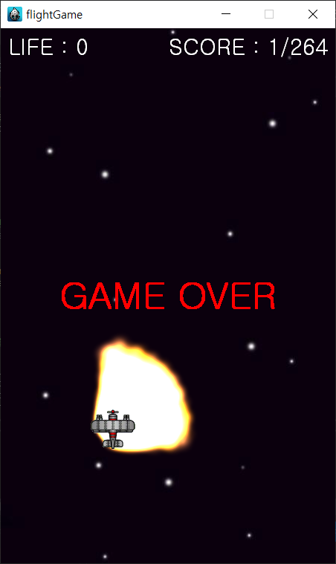
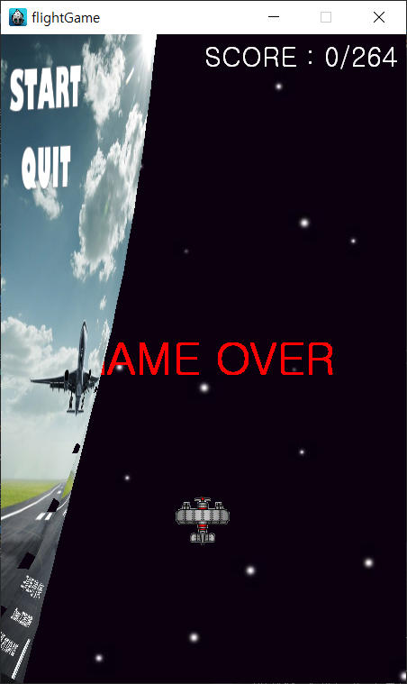
void GameScene::GameOver() ⬅게임이 끝났다는걸 알려주는 라벨
{
auto label = Label::createWithSystemFont("GAME OVER", "", 50);
label->setPosition(Vec2(winSize.width / 2, winSize.height / 2));
label->setColor(Color3B::RED);
this->addChild(label);
isTurn = true;
}
void GameScene::changeScenes(Ref* sender) ⬅ 화면 전환
{
StopMusic();
auto scene = TransitionPageTurn::create(1.0, MenuScene::createScene(), true);
Director::getInstance()->replaceScene(scene);
}

